Slide 1
Hardness and compressed index
6.26

Slide 2
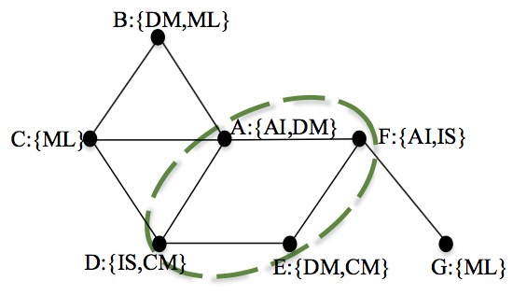
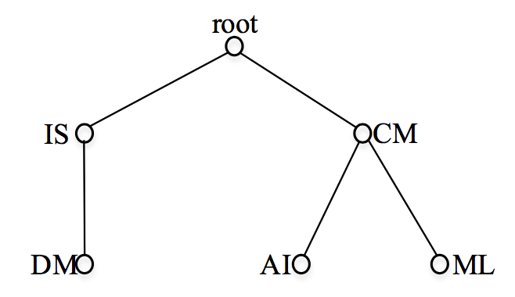
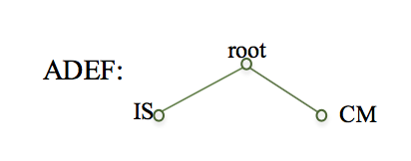
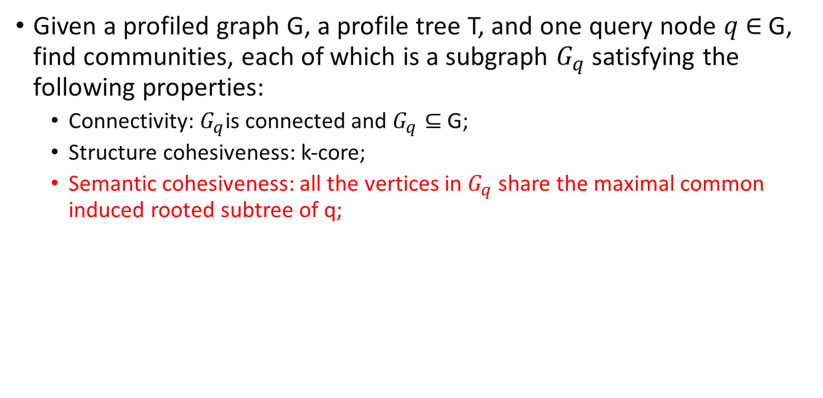
Problem definition
Given a profiled graph G, a profile tree T, and one query node $q$ $∈$ G, find communities, each of which is a subgraph $G_{q}$ satisfying the following properties:
Connectivity: $G_{q}$is connected and $G_{q}⊆$ G;
Structure cohesiveness: k-core;
Semantic cohesiveness: all the vertices in $G_{q}$ share the maximal common induced rooted subtree of q;

Slide 3
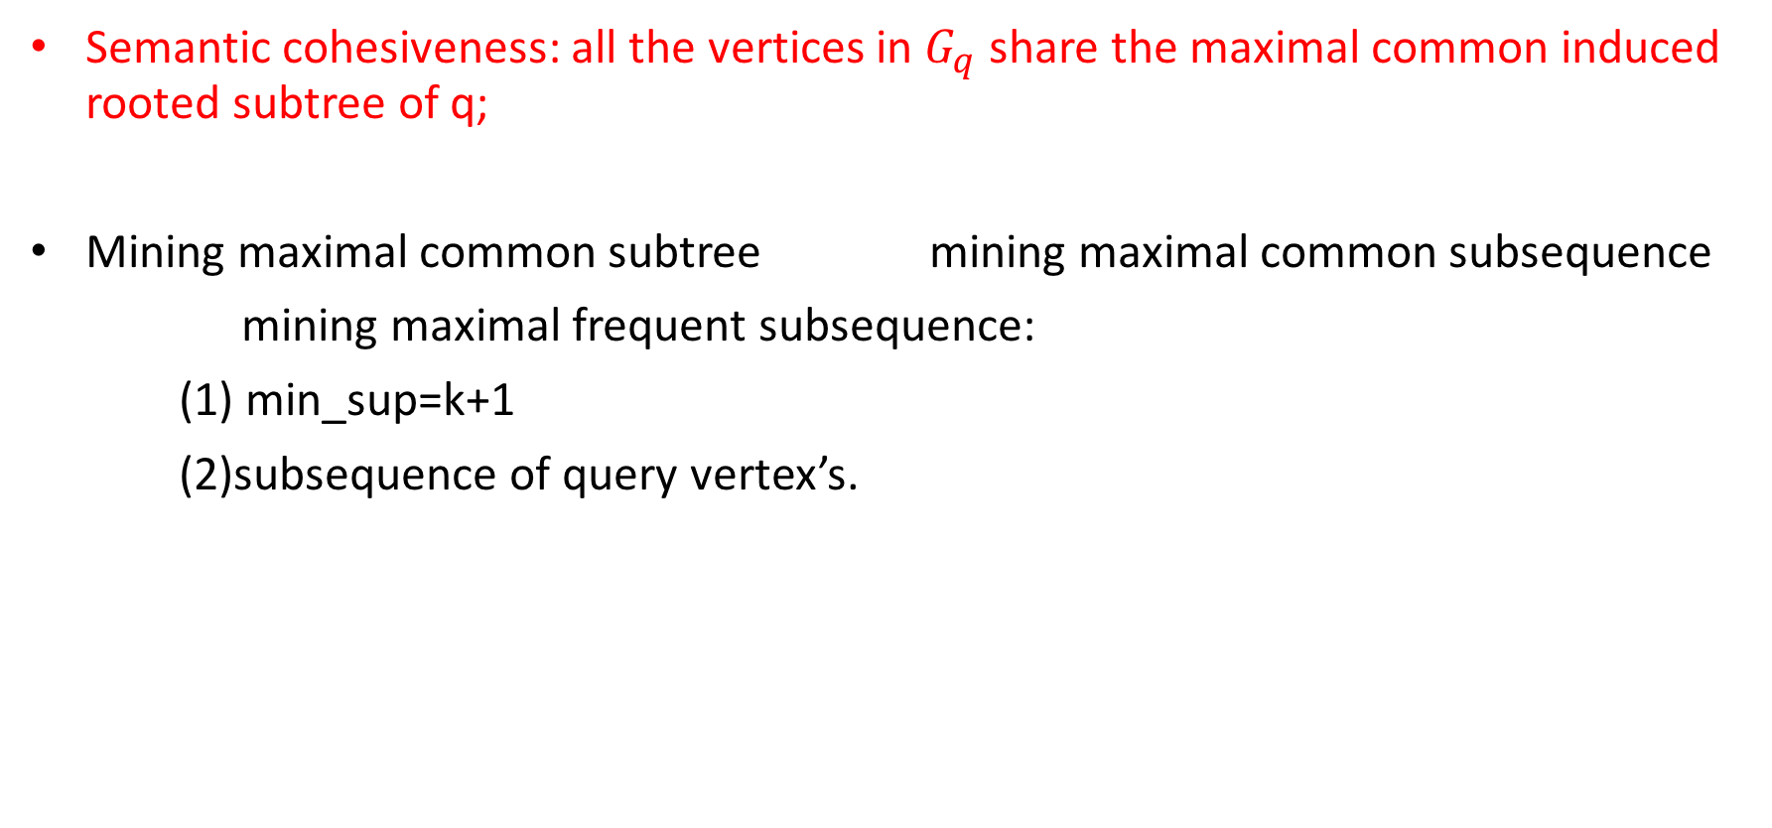
Transformation from tree to sequence
Semantic cohesiveness: all the vertices in $G_{q}$ share the maximal common induced rooted subtree of q;
Mining maximal common subtree mining maximal common subsequence
mining maximal frequent subsequence:
(1) min_sup=k+1
(2)subsequence of query vertex’s.

Slide 4
Hardness of mining all frequent subsequences
“If a counting problem is #P-complete[3] or #P-hard, then its associated problem of enumerating all solution must be NP-hard.”[1,2]
Our target is to prove that counting the number of all maximal common subsequences is #P-hard.
[1].Michael R G, David S J. Computers and intractability: a guide to the theory of NP-completeness[J]. WH Free. Co., San Fr, 1979: 90-91.
[2].Papadimitriou C H. Computational complexity[M]. John Wiley and Sons Ltd., 2003.
[3].Valiant L G. The complexity of computing the permanent[J]. Theoretical computer science, 1979, 8(2): 189-201.

Slide 5
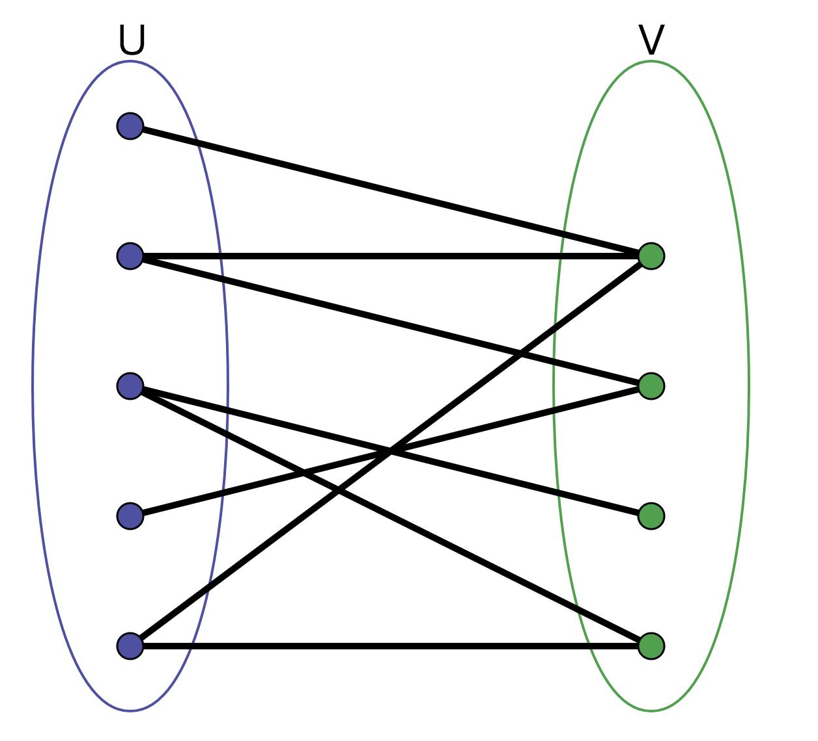
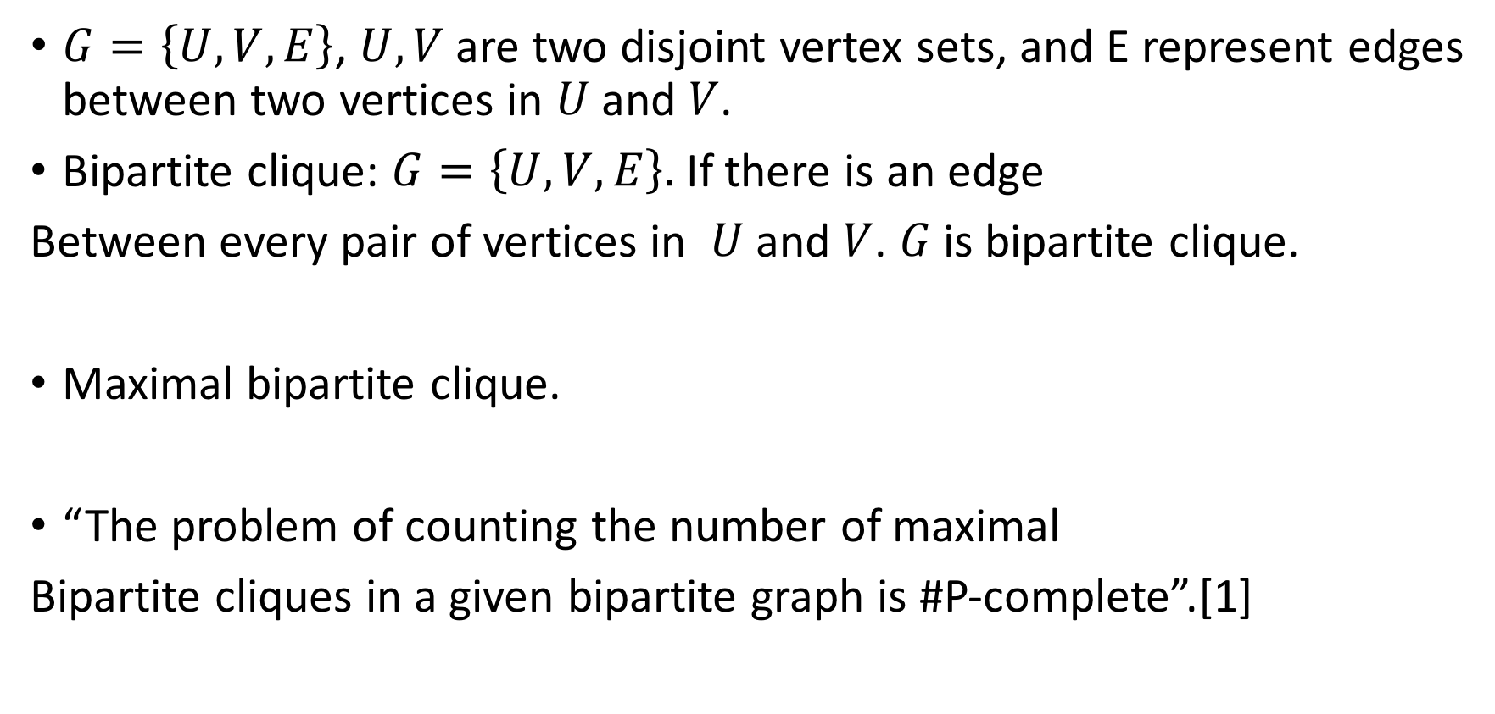
Bipartite graph
$G=\left\{U,V,E\right\}$, $U,V$ are two disjoint vertex sets, and E represent edges between two vertices in $U$and $V$.
Bipartite clique: $G=\left\{U,V,E\right\}.$ If there is an edge
Between every pair of vertices in $U$and $V$. $G$ is bipartite clique.
Maximal bipartite clique.
“The problem of counting the number of maximal
Bipartite cliques in a given bipartite graph is #P-complete”.[1]
[1]Provan J S, Ball M O. The complexity of counting cuts and of computing the probability that a graph is connected[J]. SIAM Journal on Computing, 1983, 12(4): 777-788.

Slide 6
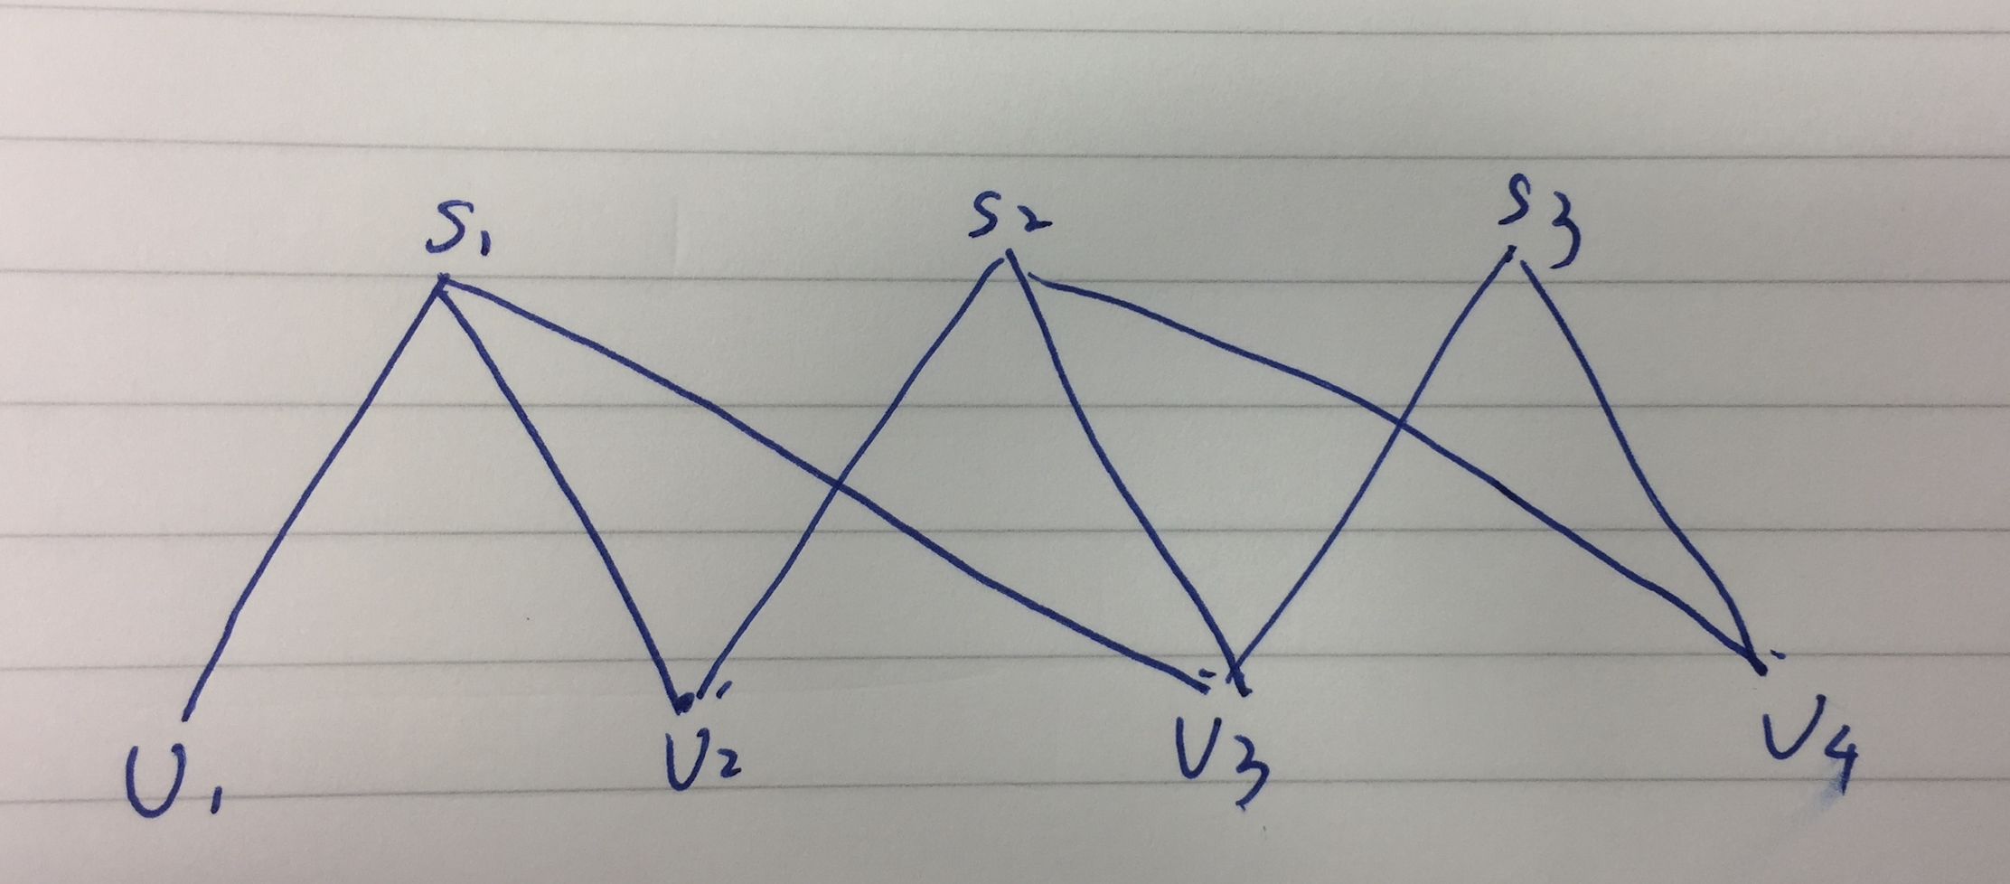
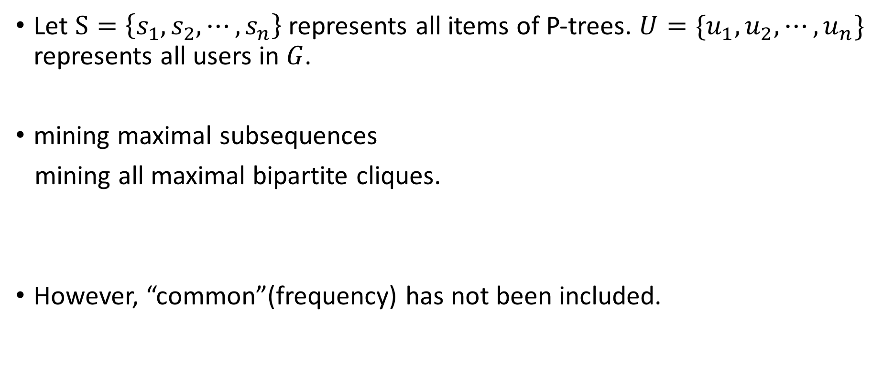
Cont.
Let $S=\left\{s_{1},s_{2}, ⋯,s_{n}\right\}$ represents all items of P-trees. $U=\{u_{1},u_{2}, ⋯,u_{n}\}$ represents all users in $G$.
mining maximal subsequences
mining all maximal bipartite cliques.
However, “common”(frequency) has not been included.

Slide 7
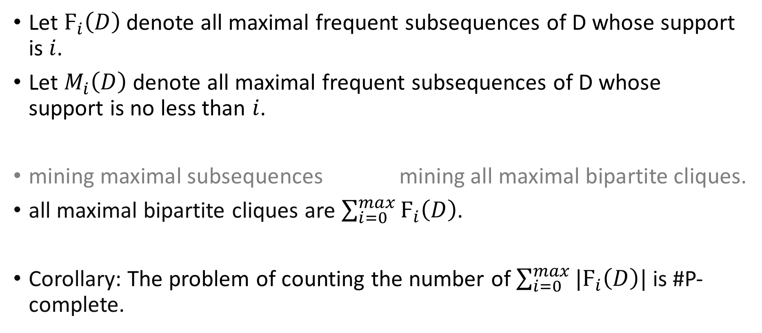
Cont.
Let $Ϝ_{i}\left(D\right)$ denote all maximal frequent subsequences of D whose support is $i$.
Let $M_{i}\left(D\right)$ denote all maximal frequent subsequences of D whose support is no less than $i$.
mining maximal subsequences mining all maximal bipartite cliques.
all maximal bipartite cliques are $\sum_{i=0}^{max}{Ϝ_{i}\left(D\right)}$.
Corollary: The problem of counting the number of $\sum_{i=0}^{max}{{|Ϝ}_{i}\left(D\right)|}$ is #P-complete.

Slide 8
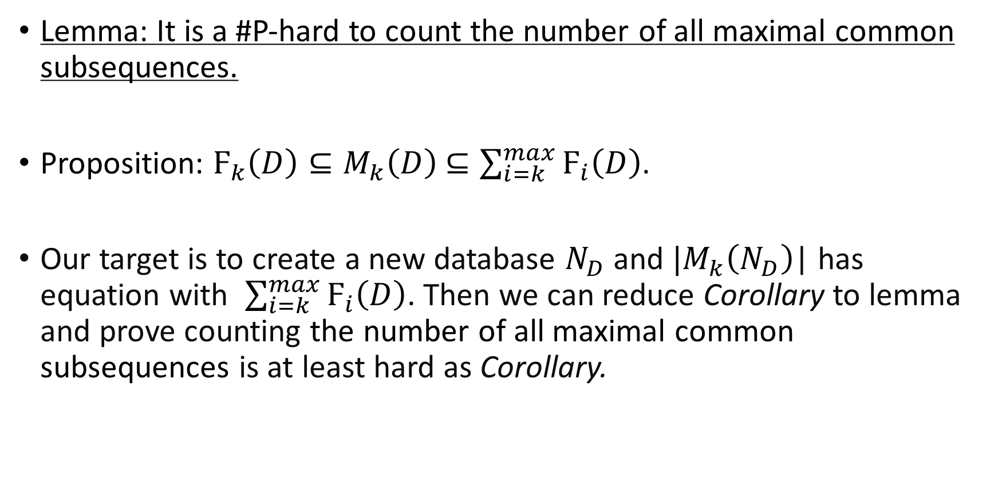
Cont.
Lemma: It is a #P-hard to count the number of all maximal common subsequences.
Proposition: $Ϝ_{k}\left(D\right)⊆M_{k}\left(D\right)$ $⊆\sum_{i=k}^{max}{Ϝ_{i}\left(D\right)}$.
Our target is to create a new database $N_{D}$ and $|M_{k}\left(N_{D}\right)$| has equation with $\sum_{i=k}^{max}{Ϝ_{i}\left(D\right)}$. Then we can reduce Corollary to lemma and prove counting the number of all maximal common subsequences is at least hard as Corollary.

Slide 9
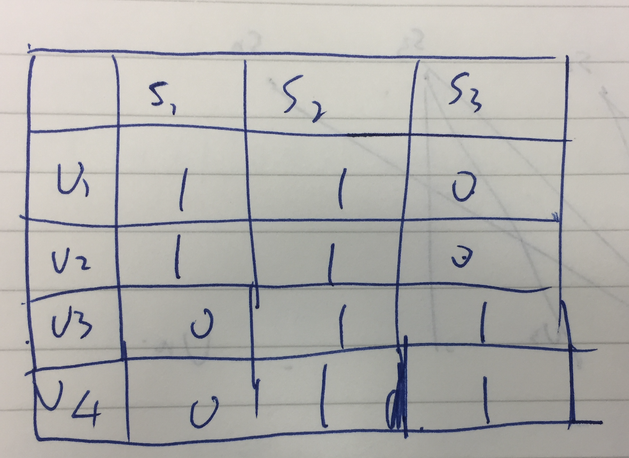
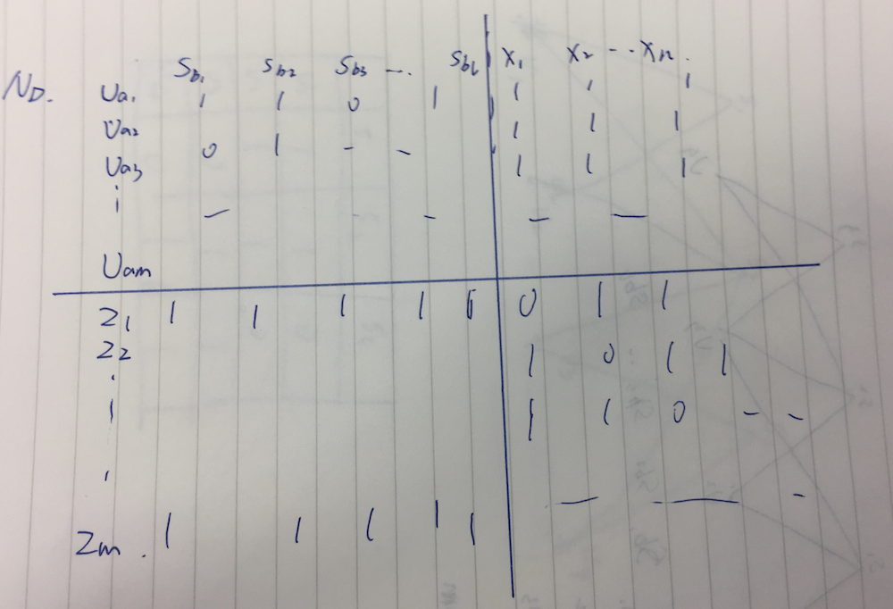
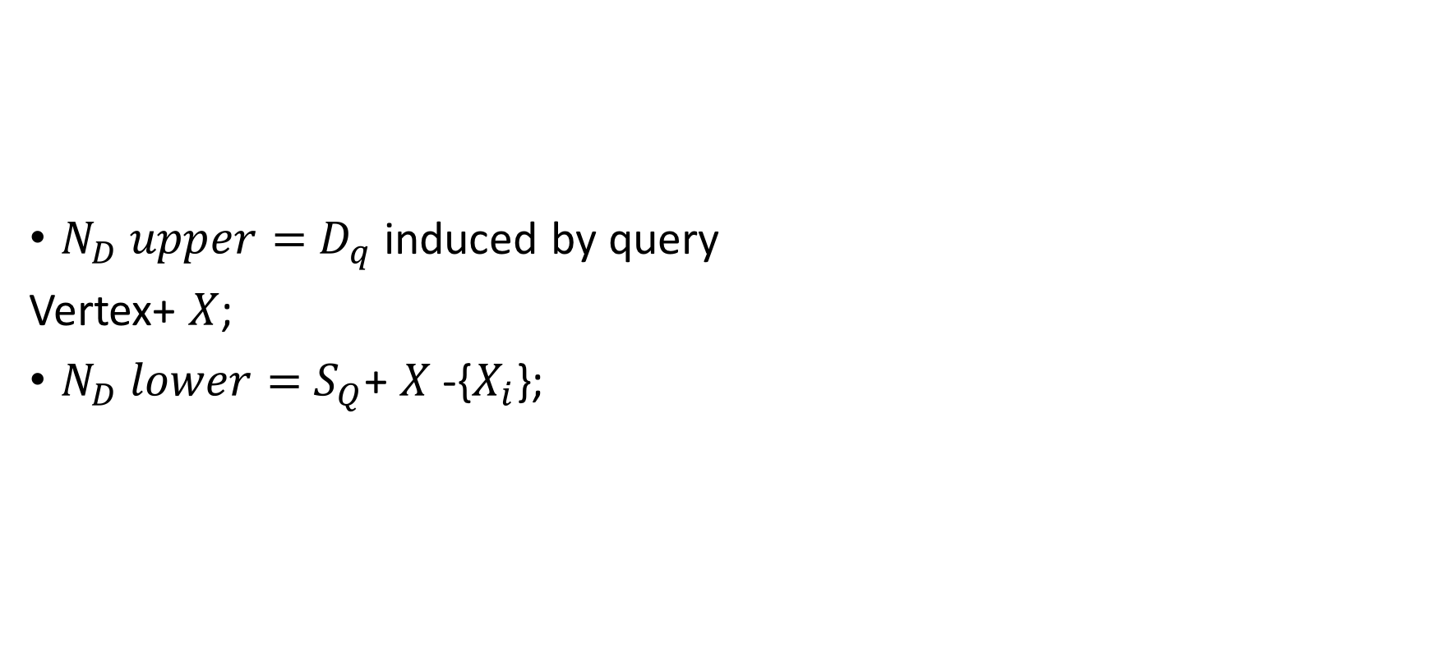
Matrix representation
$N_{D} upper=$ $D_{q}$ induced by query
Vertex+ $X$;
$N_{D} lower=$ $S_{Q}$+ $X$-{$X_{i}$};

Slide 10
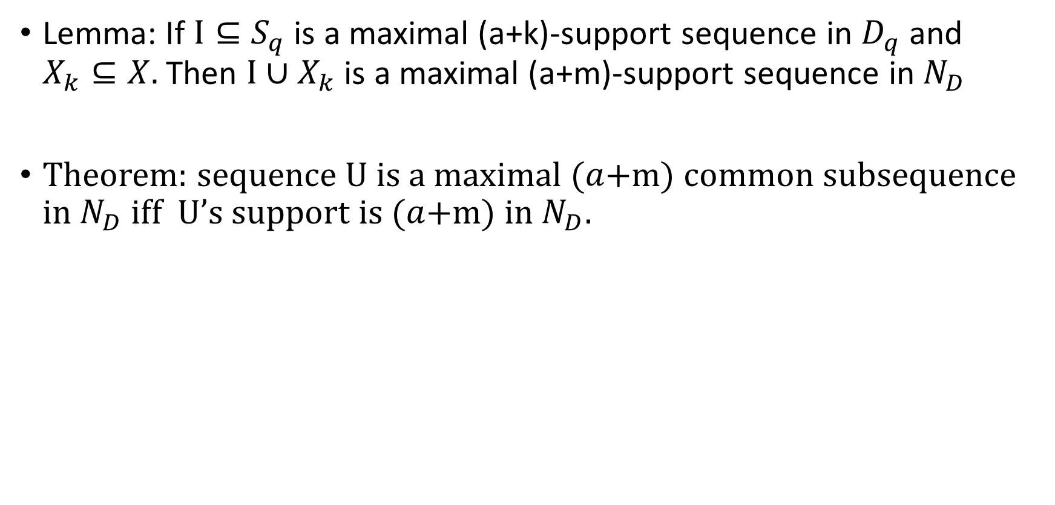
Lemma: If $I⊆S_{q}$ is a maximal (a+k)-support sequence in $D_{q}$ and $X_{k}⊆X.$Then $I∪X_{k}$ is a maximal (a+m)-support sequence in${ N}_{D}$
Theorem: sequence U is a maximal ($a$+m) common subsequence in $N_{D}$ iff U’s support is ($a$+m) in $N_{D}$.

Slide 11
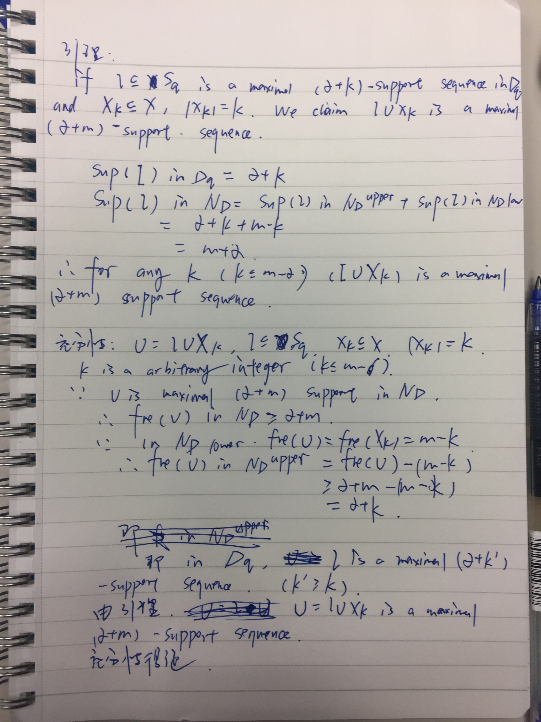
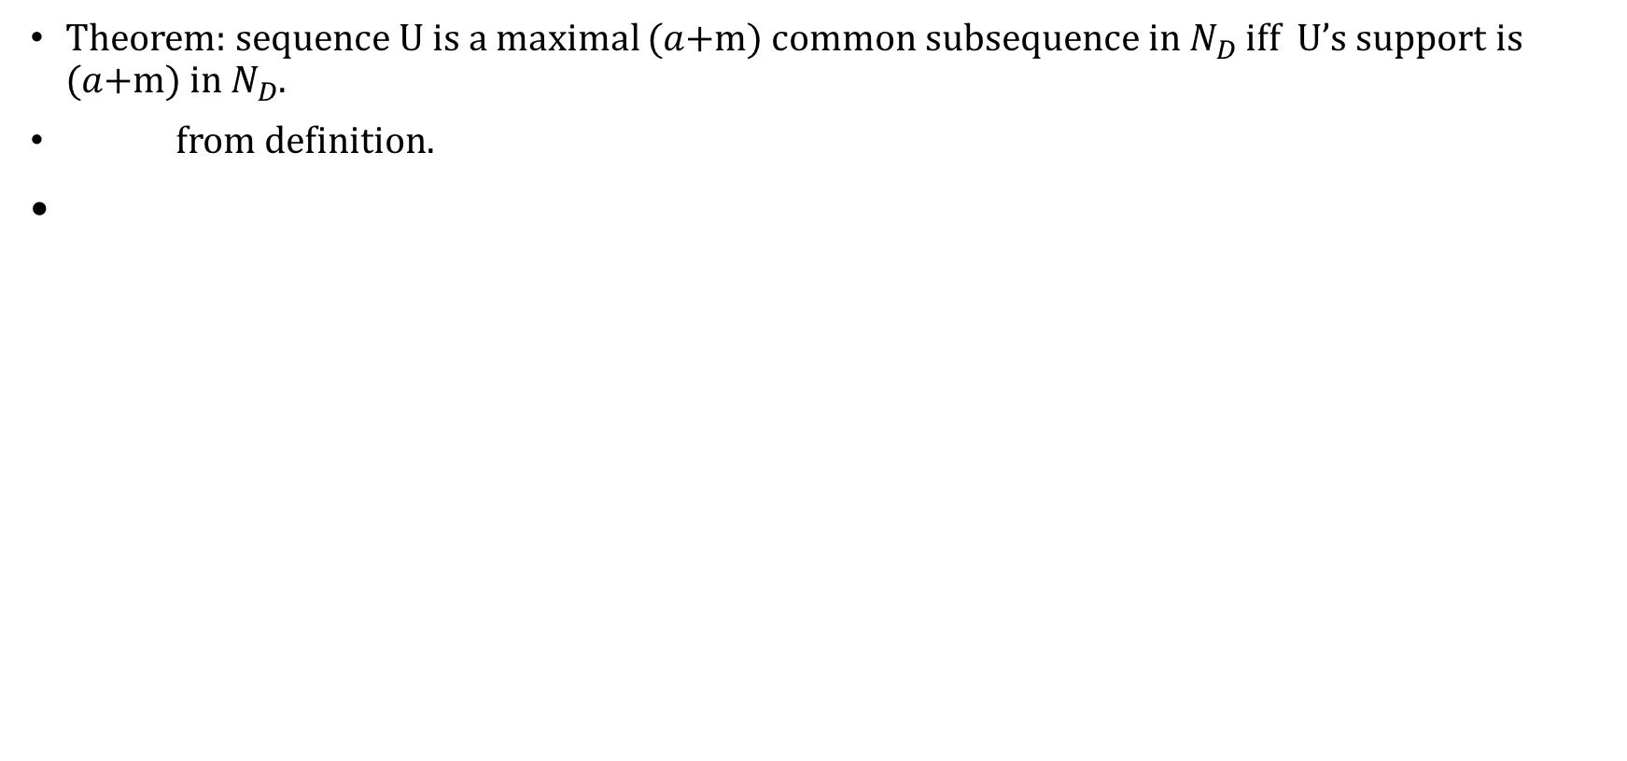
proof
Theorem: sequence U is a maximal ($a$+m) common subsequence in $N_{D}$ iff U’s support is ($a$+m) in $N_{D}$.
from definition.

Slide 12
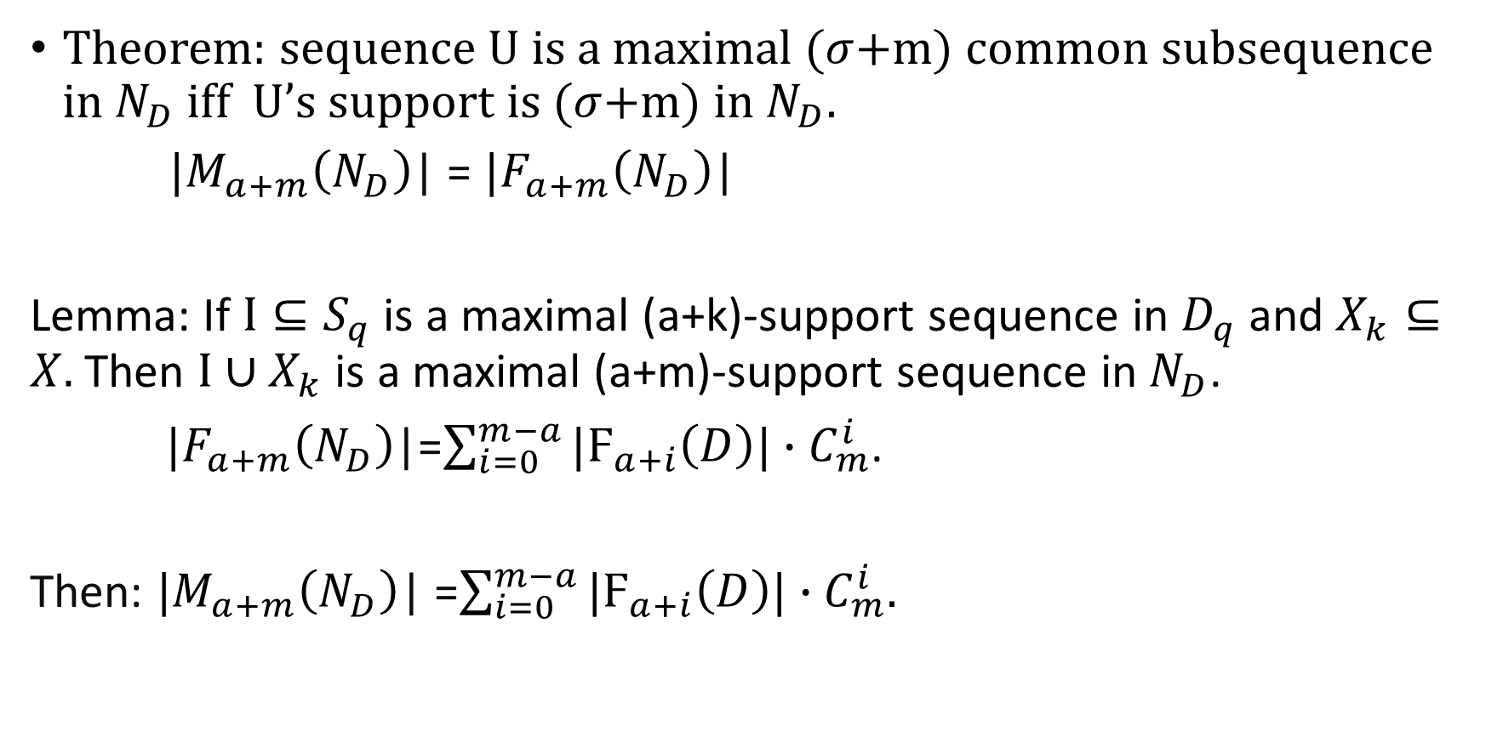
Conclusion
Theorem: sequence U is a maximal ($σ$+m) common subsequence in $N_{D}$ iff U’s support is ($σ$+m) in $N_{D}$.
$|M_{a+m}\left(N_{D}\right)$| = $|F_{a+m}\left(N_{D}\right)$|
Lemma: If $I⊆S_{q}$ is a maximal (a+k)-support sequence in $D_{q}$ and $X_{k}⊆X.$Then $I∪X_{k}$ is a maximal (a+m)-support sequence in${ N}_{D}$.
$|F_{a+m}\left(N_{D}\right)$|=$\sum_{i=0}^{m−a}{|Ϝ_{a+i}\left(D\right)|}∙C_{m}^{i}$.
Then: $|M_{a+m}\left(N_{D}\right)$| =$\sum_{i=0}^{m−a}{|Ϝ_{a+i}\left(D\right)|}∙C_{m}^{i}$.

Slide 13
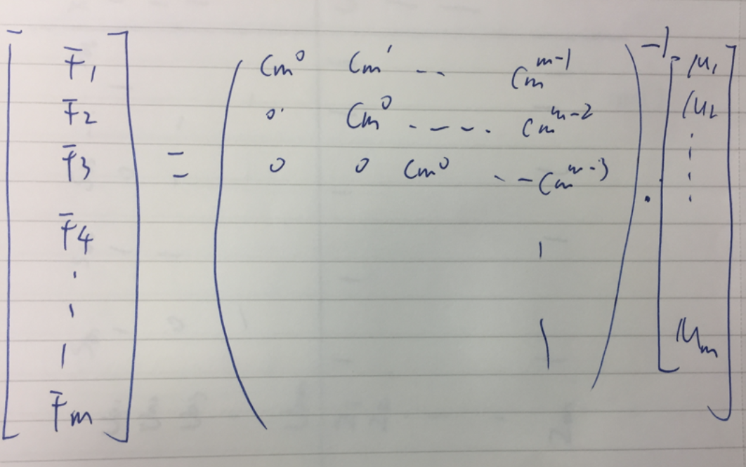
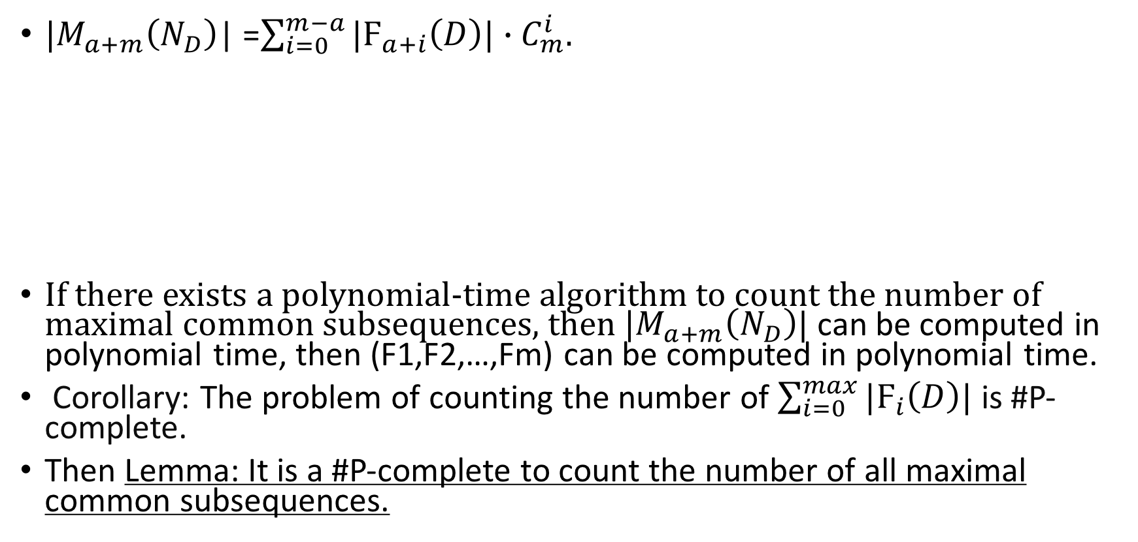
Reduction
$|M_{a+m}\left(N_{D}\right)$| =$\sum_{i=0}^{m−a}{|Ϝ_{a+i}\left(D\right)|}∙C_{m}^{i}$.
If there exists a polynomial-time algorithm to count the number of maximal common subsequences, then ${|M}_{a+m}\left(N_{D}\right)$| can be computed in polynomial time, then (F1,F2,…,Fm) can be computed in polynomial time.
Corollary: The problem of counting the number of $\sum_{i=0}^{max}{{|Ϝ}_{i}\left(D\right)|}$ is #P-complete.
Then Lemma: It is a #P-complete to count the number of all maximal common subsequences.

Slide 14
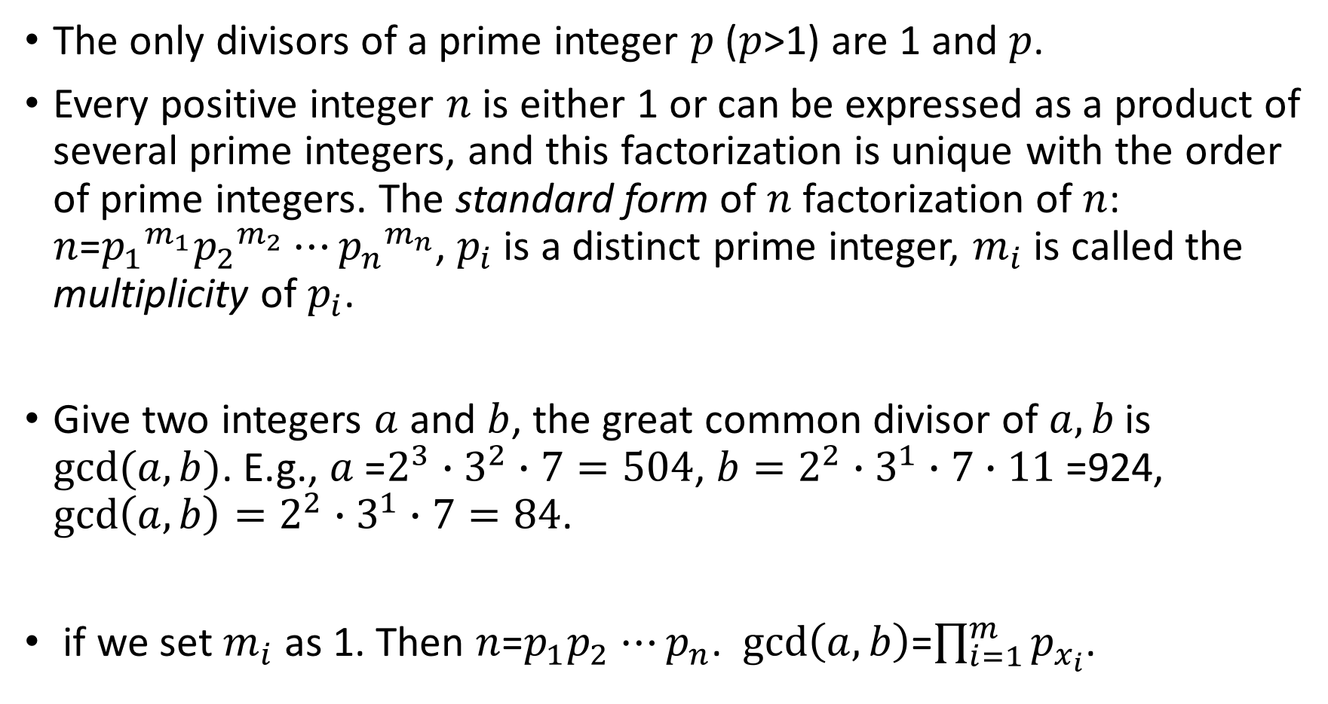
compressed index-mathematic preliminary
The only divisors of a prime integer $p$ ($p$>1) are 1 and $p$.
Every positive integer $n$ is either 1 or can be expressed as a product of several prime integers, and this factorization is unique with the order of prime integers. The standard form of $n$ factorization of $n$: $n$=${p_{1}}^{m_{1}}{p_{2}}^{m_{2}}⋯{p_{n}}^{m_{n}}$, $p_{i}$ is a distinct prime integer, $m_{i}$ is called the multiplicity of $p_{i}$.
Give two integers $a$ and $b$, the great common divisor of $a,b$ is $gcd(a,b)$. E.g., $a$=$2^{3}∙3^{2}∙7=504$, ${b=2}^{2}∙3^{1}∙7$ $∙11$ =924, $gcd\left(a,b\right)=2^{2}∙3^{1}∙7=84$.
if we set $m_{i}$ as 1. Then $n$=$p_{1}p_{2}$ $⋯p_{n}$. $gcd\left(a,b\right)$=$\prod_{i=1}^{m}{p_{x_{i}}}$.

Slide 15
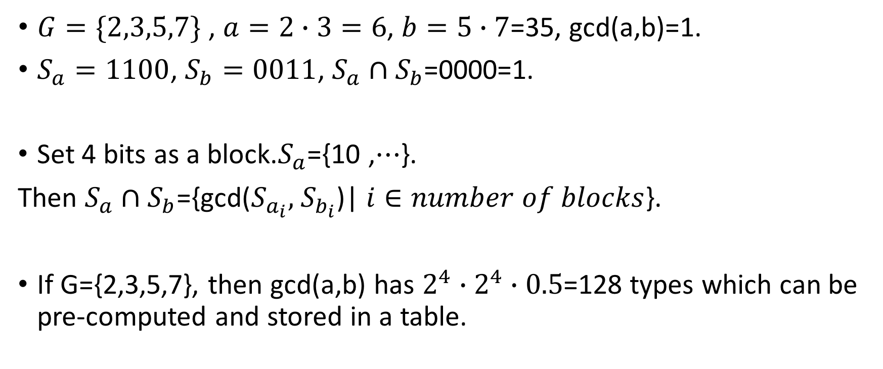
compressed index-example
$G=\{2,3,5,7\}$ , $a=2∙3=6$, $b=5∙7$=35, gcd(a,b)=1.
$S_{a}=1100$, $S_{b}=0011$, $S_{a}∩S_{b}$=0000=1.
Set 4 bits as a block.$S_{a}$={10 ,$⋯$}.
Then $S_{a}∩S_{b}$={gcd($S_{a_{i}},$ $S_{b_{i}}$)| $i∈number of blocks$}.
If G={2,3,5,7}, then gcd(a,b) has $2^{4}∙2^{4}∙0.5$=128 types which can be pre-computed and stored in a table.

Slide 16
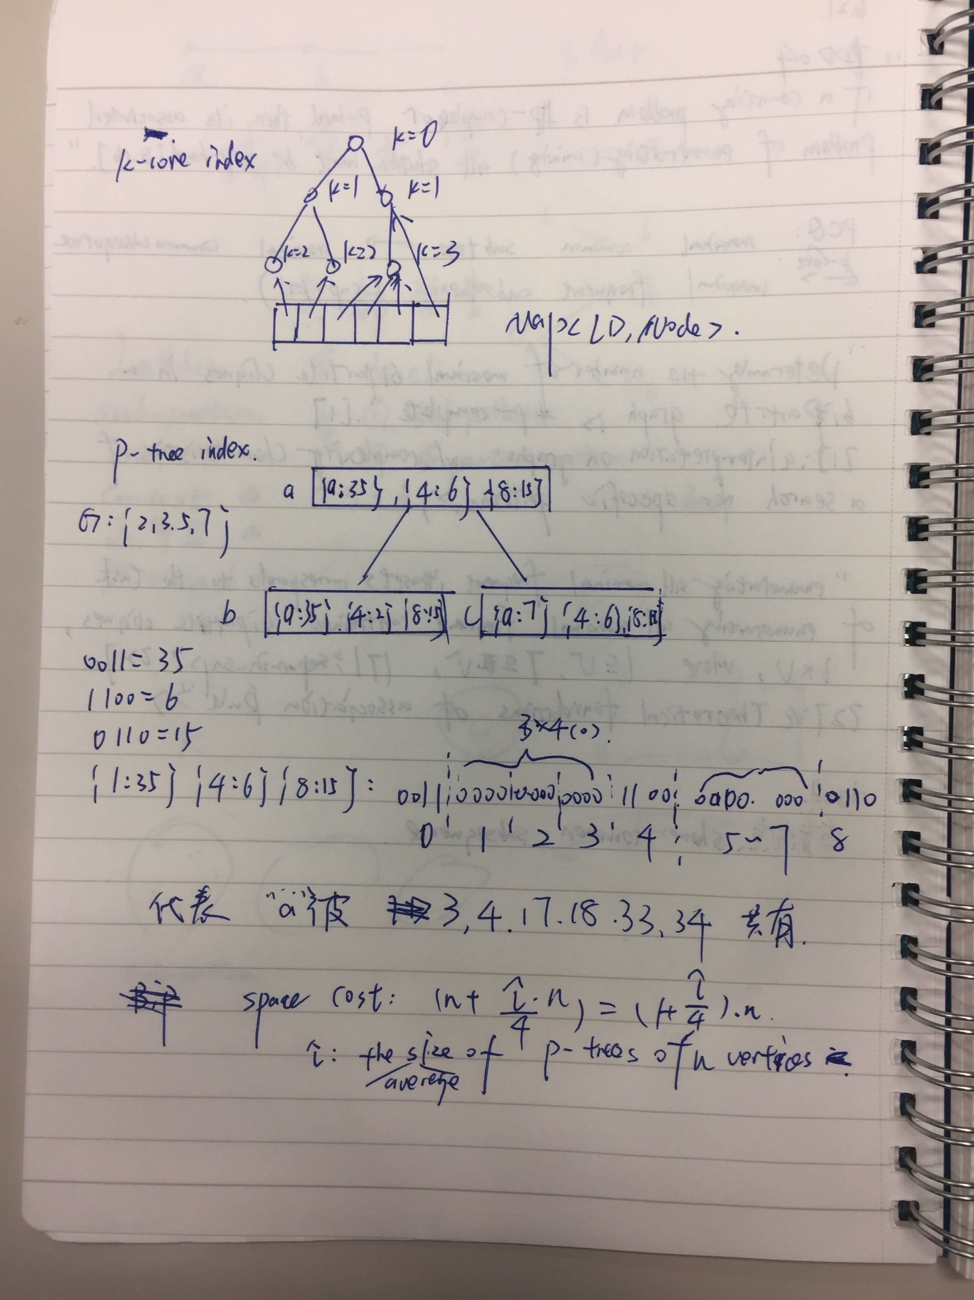
Index 3

